Slide 1
University Admission Information
Supervised by
Abdul Aziz
Lecturer
Department of CSE, Kuet
PrESENTED by
Md. Ashikuzzaman
(1607080)
Awal Ahmed Fime
(1607079)

Slide 2
University Admission Information Introduction
This a web based project.
This works as a helpdesk for admission students
This a platform to gather all authentic information at a place and display them in a organized way.

Slide 3
University Admission Information Objectives
Application system for combined admission
All the information at a same place.
Provide frequently asked questions section
Transport and accommodation information
A communication platform for students.
Interface for authority to provide their respected information as admin.

Slide 4
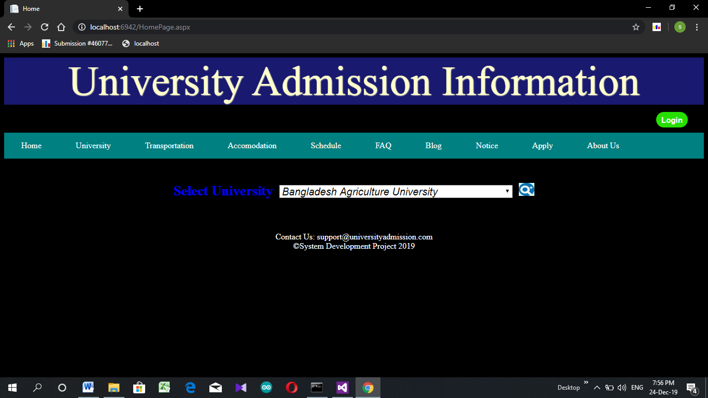
University Admission Information FeatureS

Slide 5
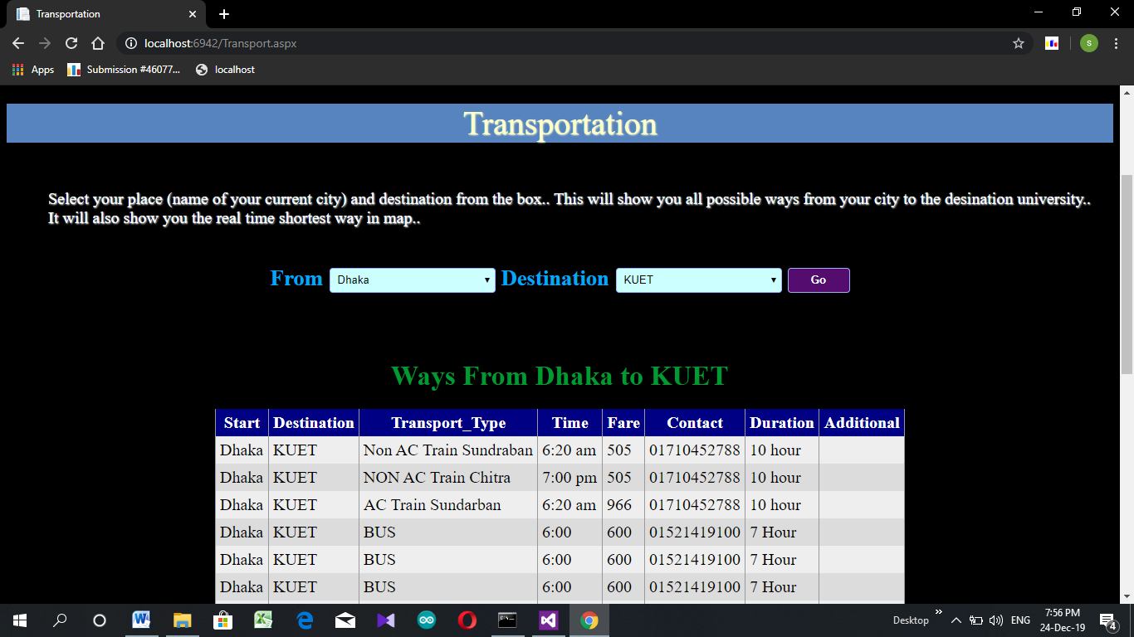
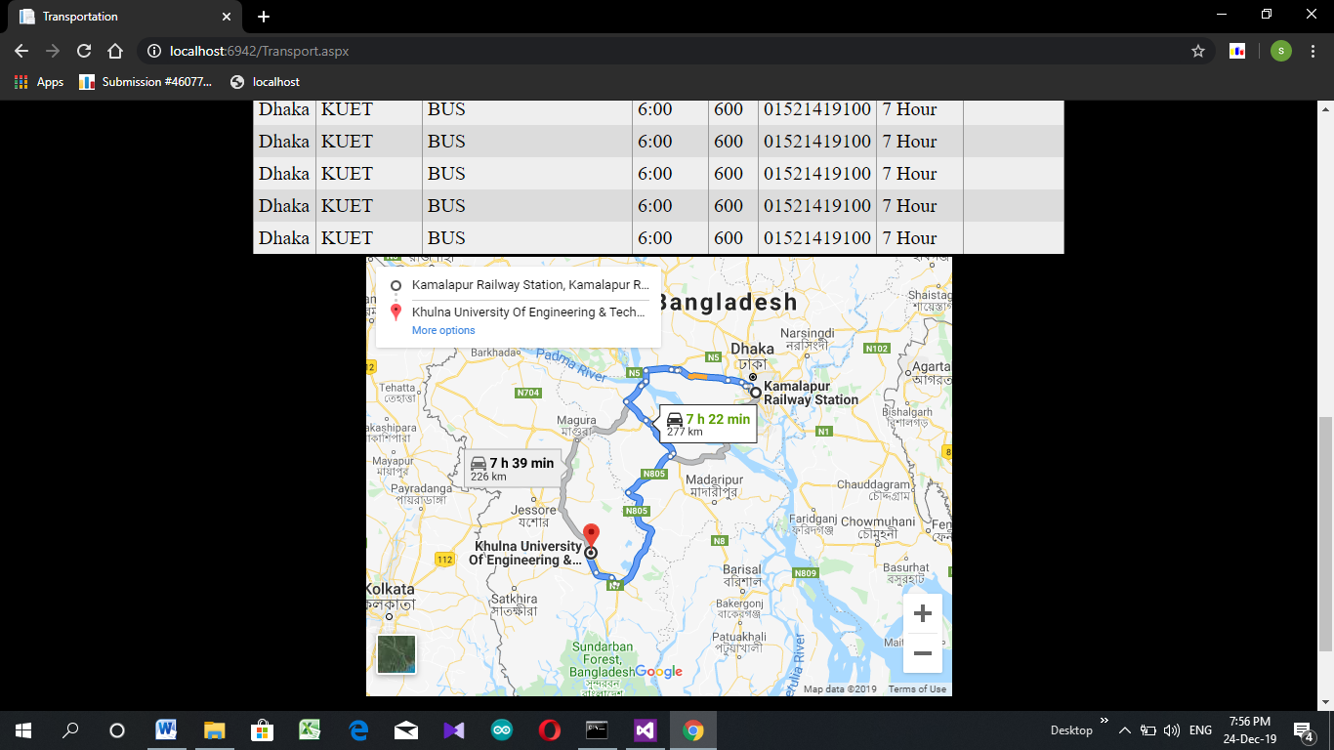
University Admission Information FeatureS

Slide 6
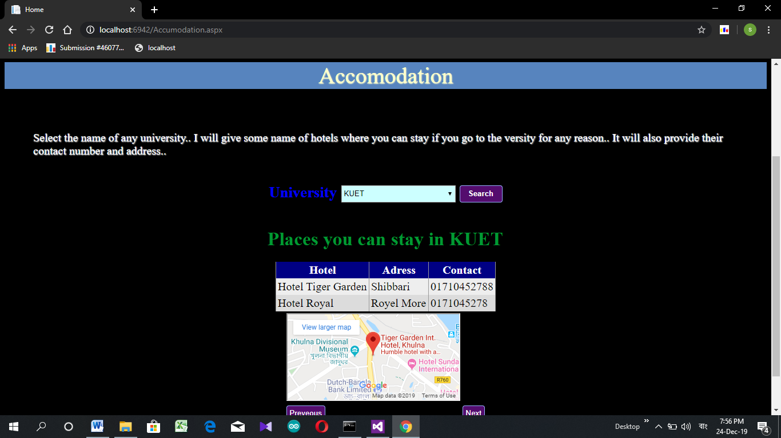
University Admission Information FeatureS

Slide 7
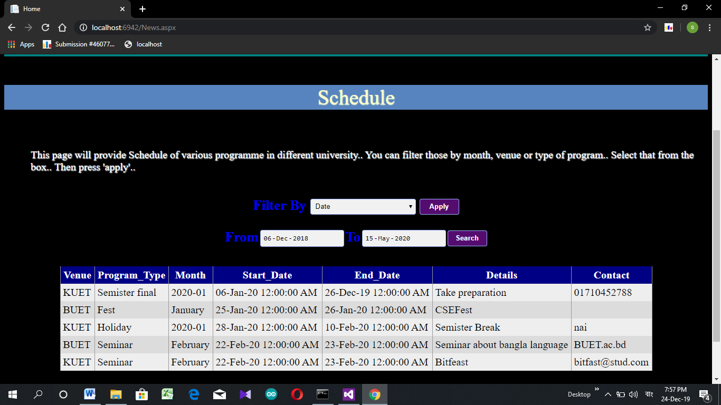
University Admission Information FeatureS

Slide 8
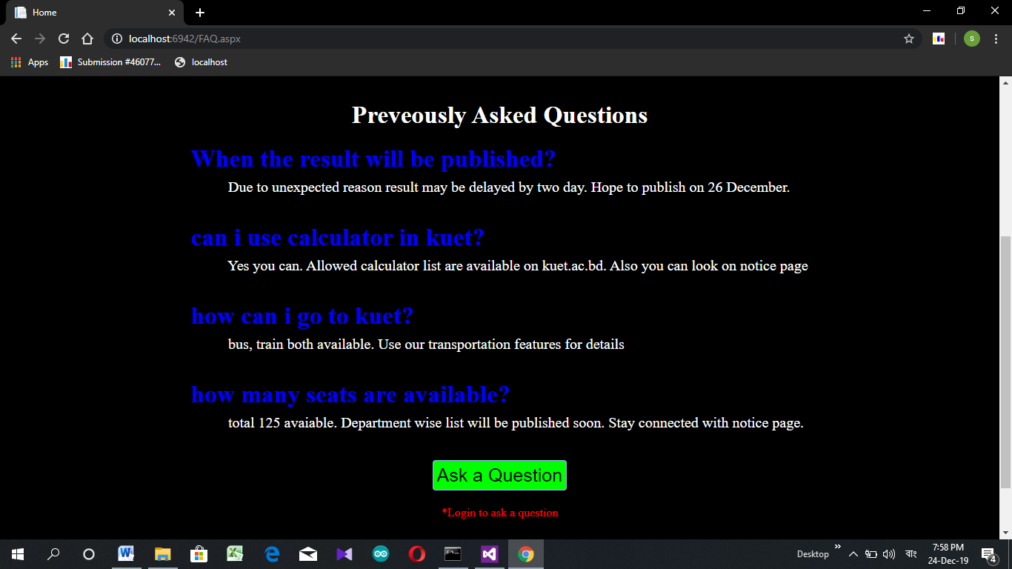
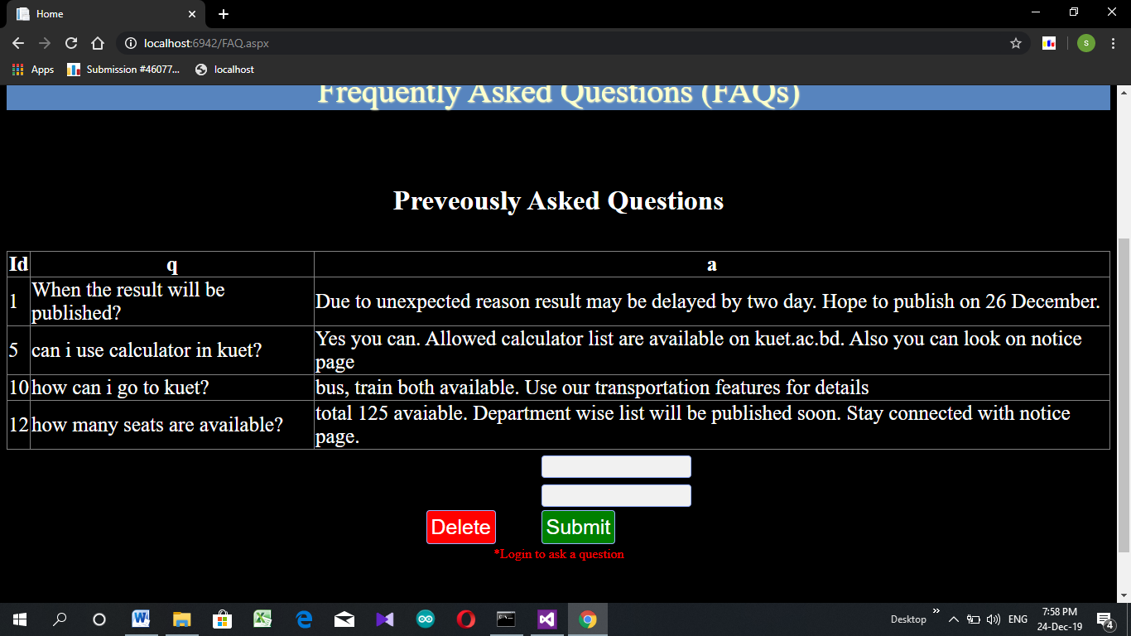
University Admission Information FeatureS

Slide 9
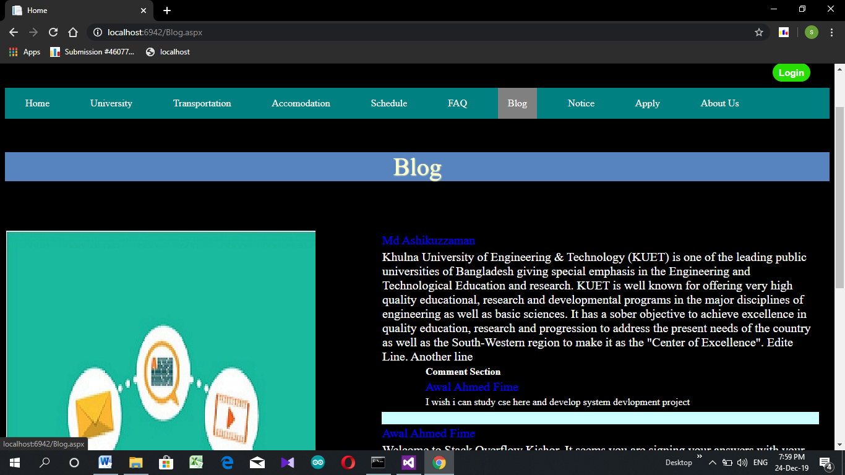
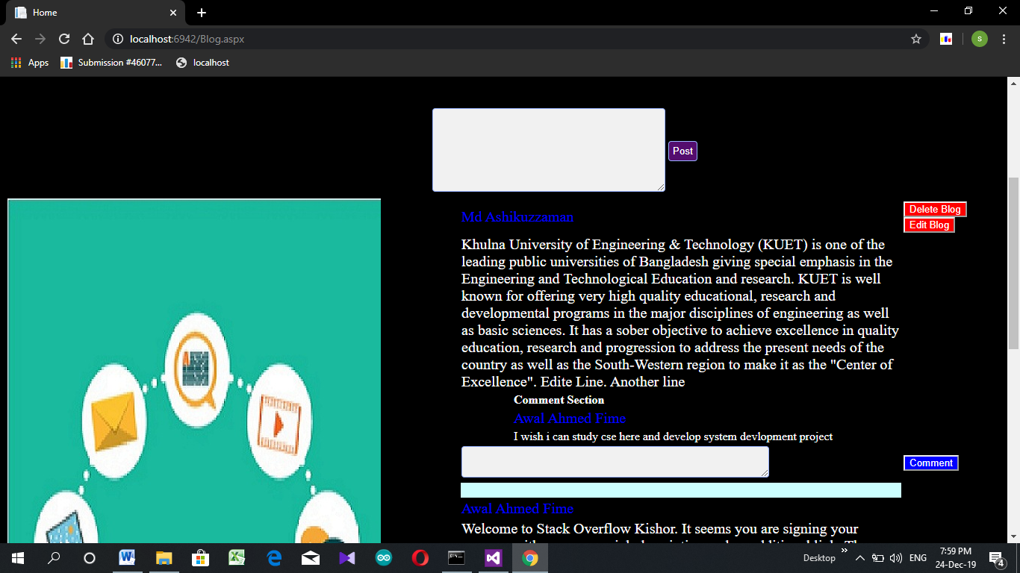
University Admission Information FeatureS

Slide 10
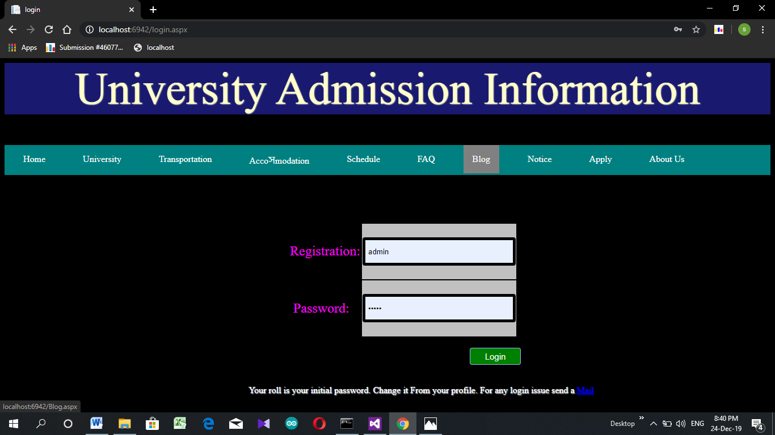
University Admission Information FeatureS

Slide 11
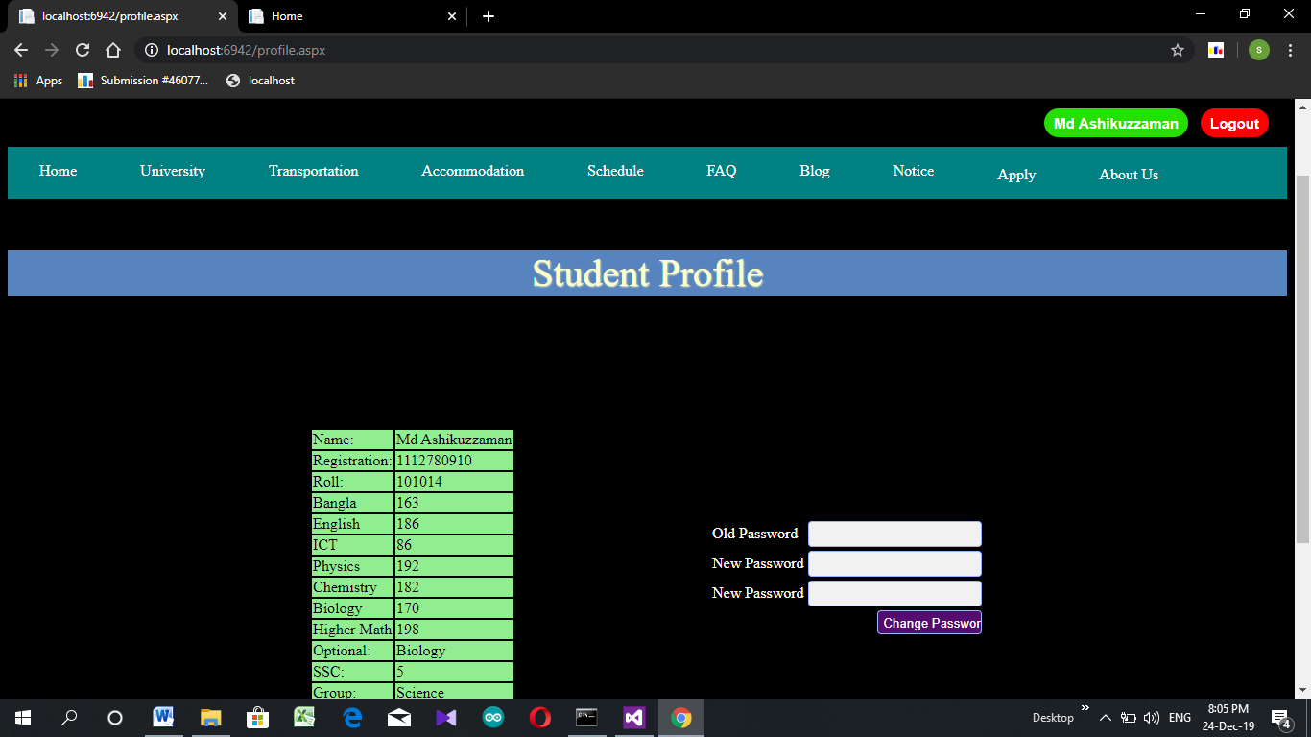
University Admission Information FeatureS

Slide 12
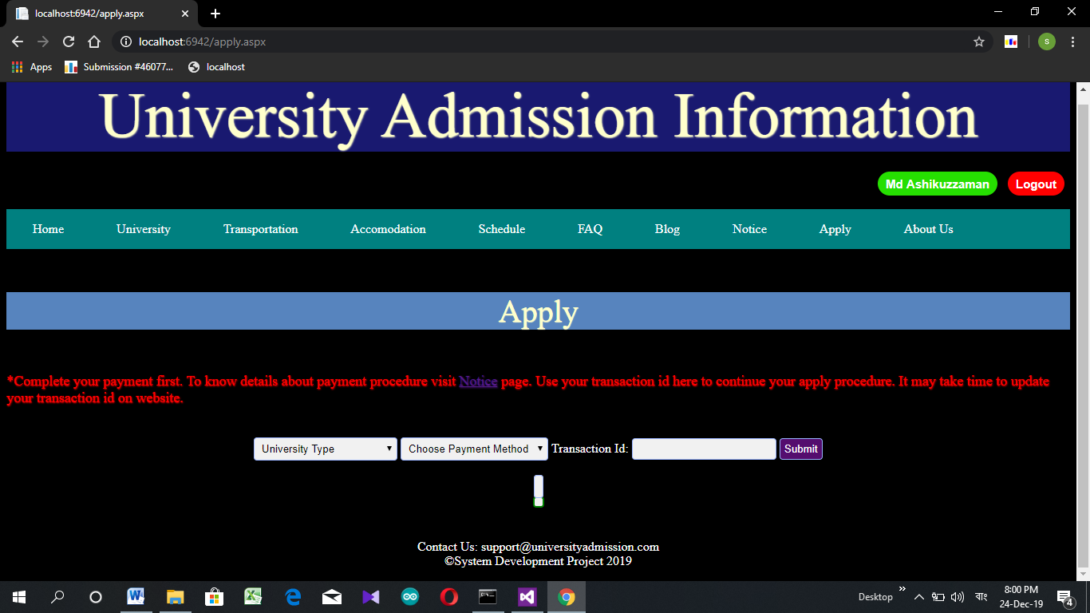
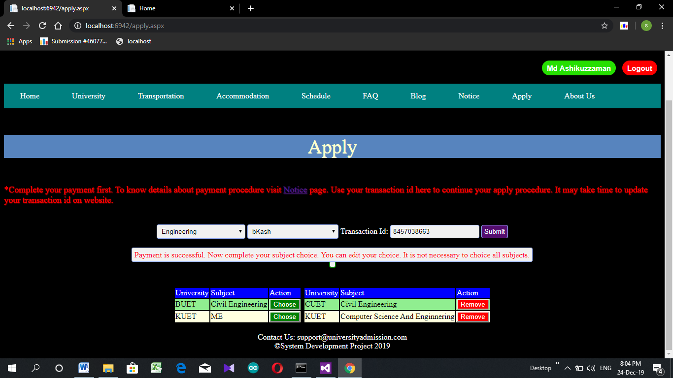
University Admission Information FeatureS

Slide 13
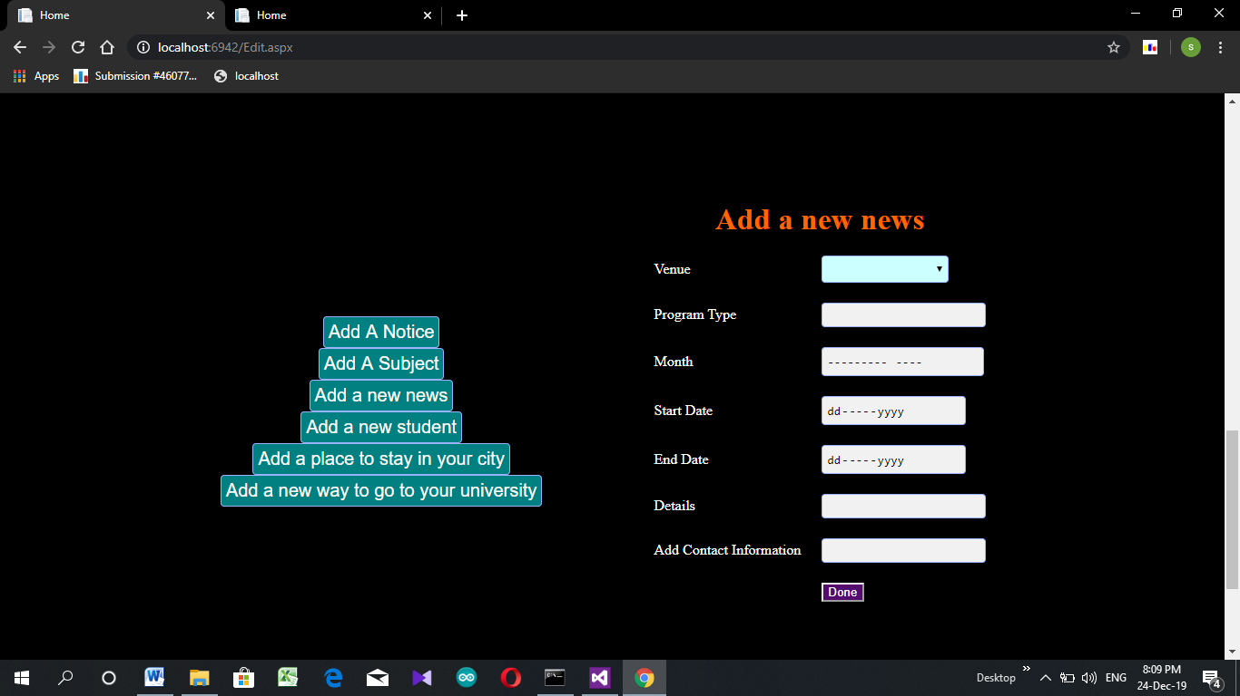
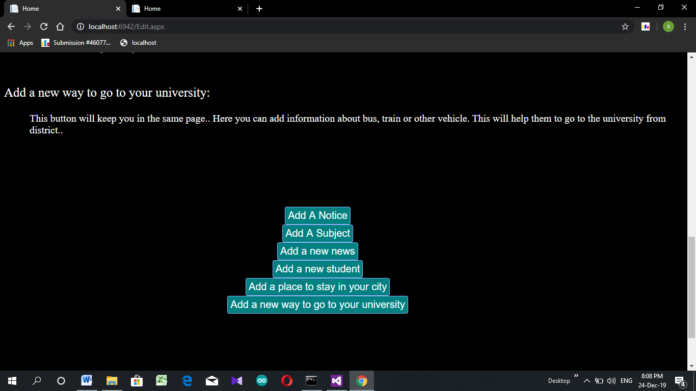
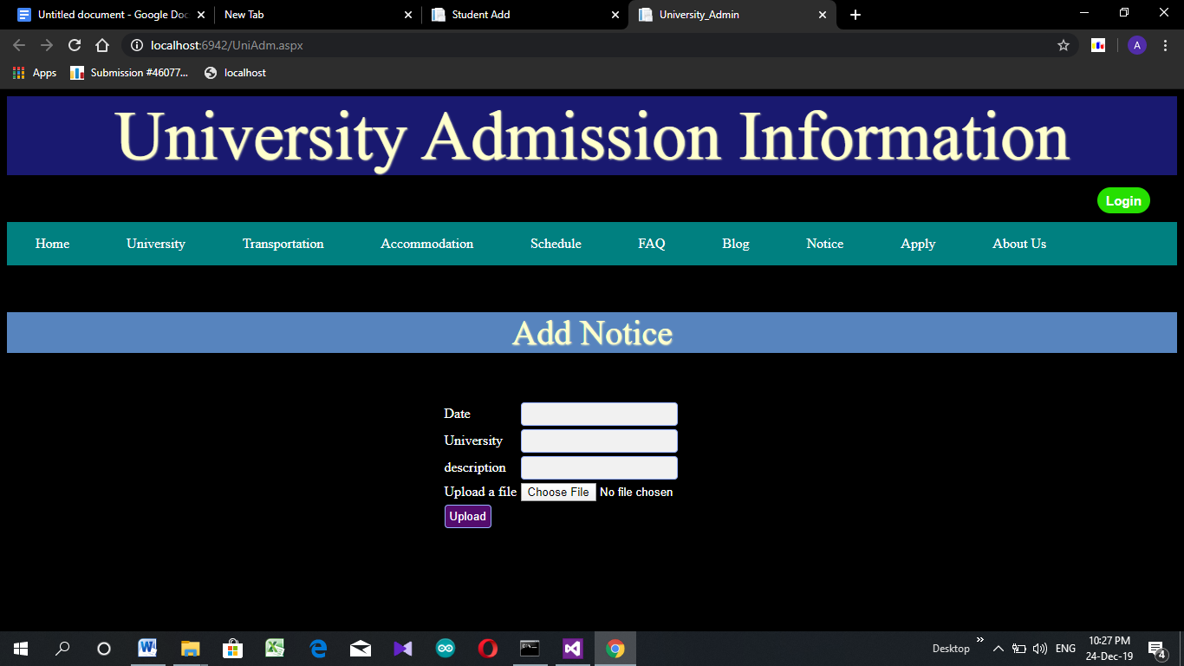
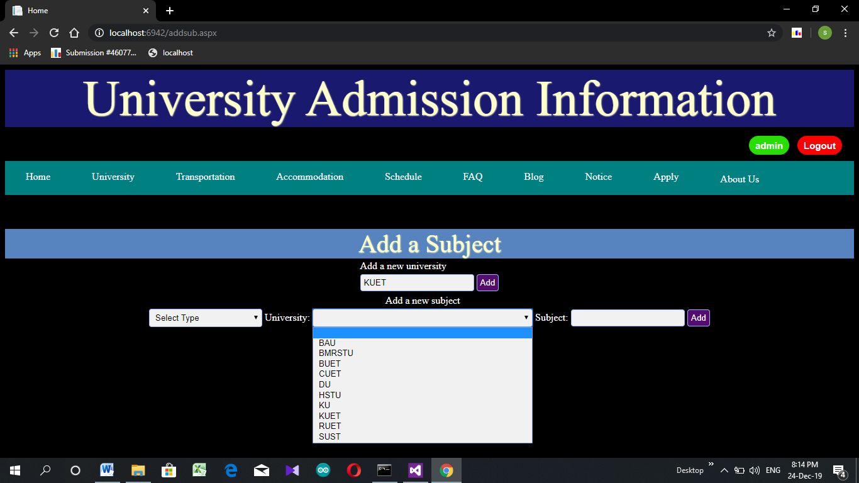
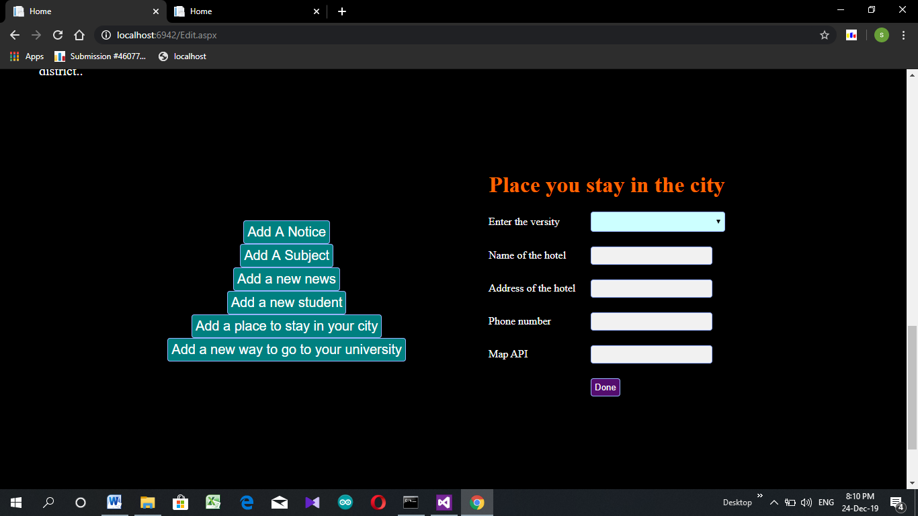
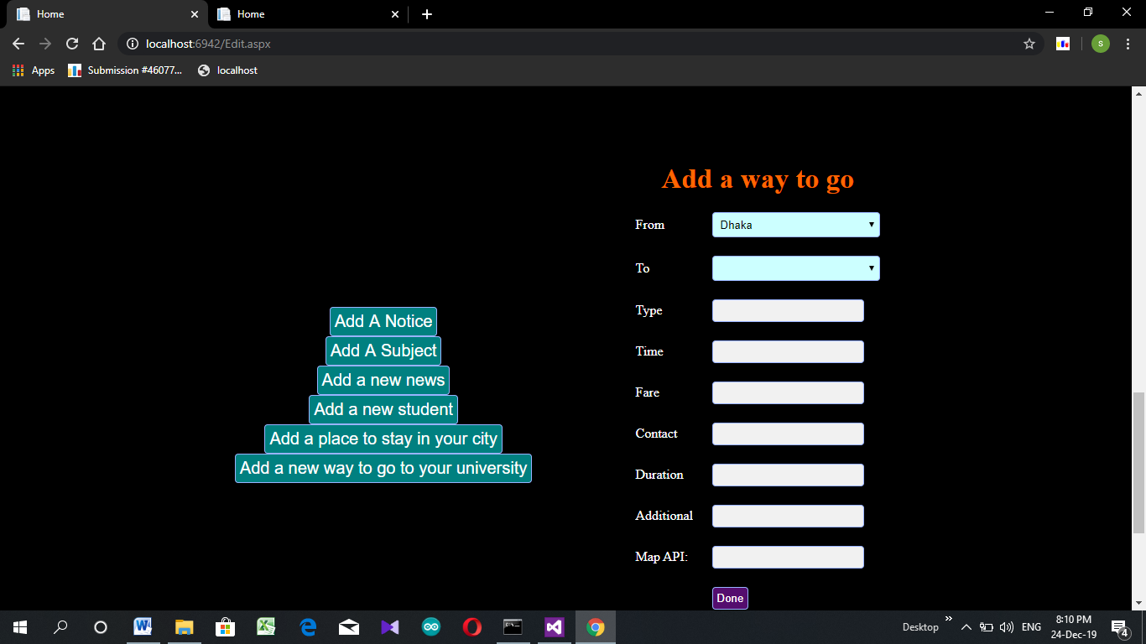
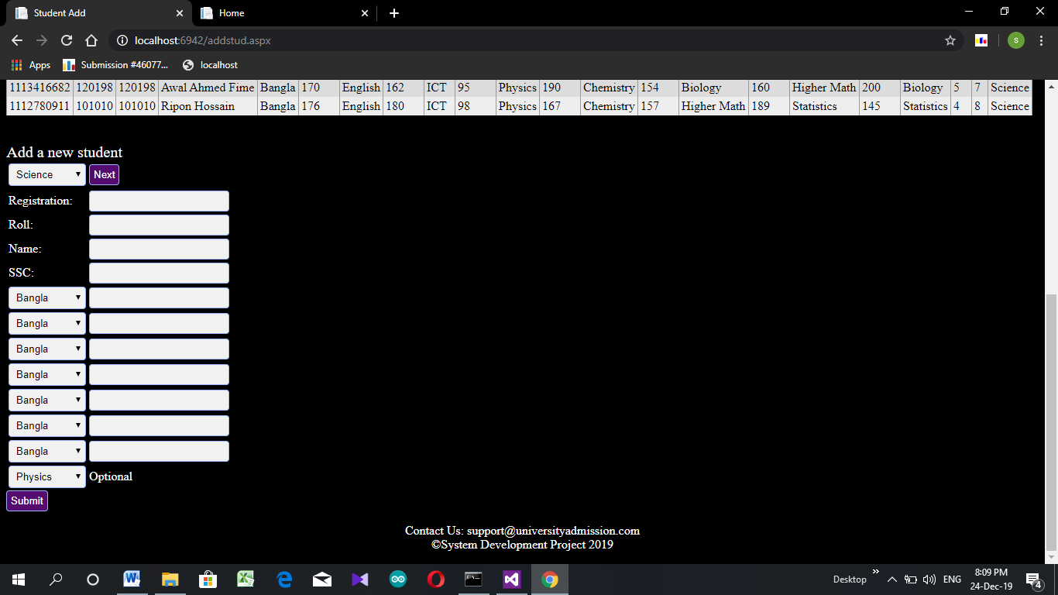
University Admission Information FeatureS

Slide 14
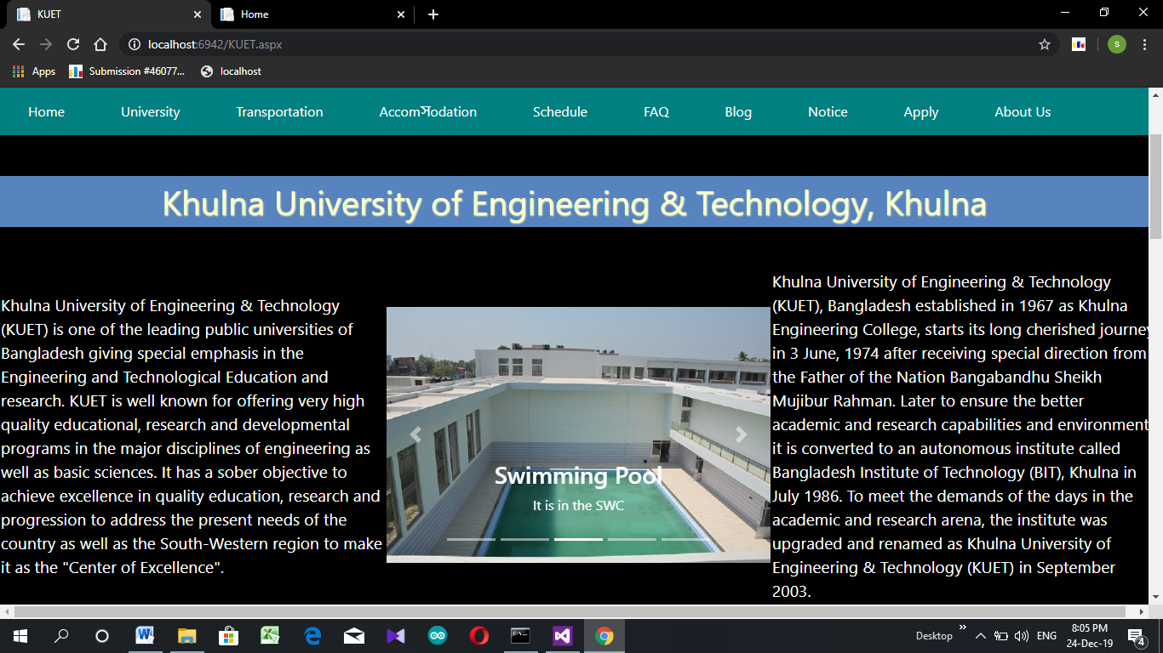
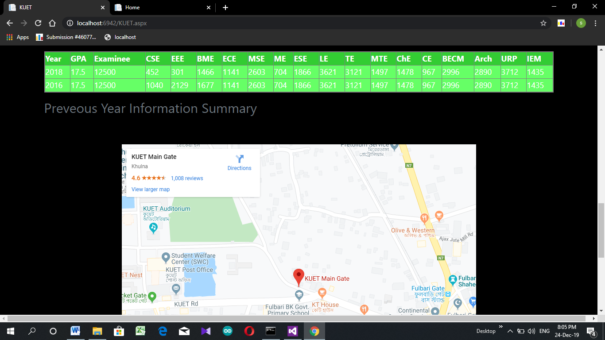
University Admission Information FeatureS

Slide 15
university Admission Information developing tools
Framework Used: Asp.net
IDE Used: Microsoft Visual Studio Ultimate 2012
Debugging Browser: Google Chrome

Slide 16
university Admission Information developing tools
Client Site:
HTML CSS JavaScript Bootstrap
Server Site:
Visual C#
DBMS:
Microsoft SQL

Slide 17
university Admission Information Limitations
Large database
Temporary table construction
Incomplete payment system
Limited file size

Slide 18
university Admission Information Reference
https://bdnews24.com/bangladesh/2013/11/26/zafar-iqbal-yasmeen-resign/
https://admissioninfos.com/agricultural-university-admission-circular-2019-20-pdf-download/
https://www.facebook.com/groups/kuetadmissioninfo/
https://www.facebook.com/groups/buetadmissiontest2016/
http://admission.kuet.ac.bd/adm/
http://www.ruet.ac.bd/admission/
https://www.cuet.ac.bd/admissiontestnotice17-18.php
https://www.buet.ac.bd/web/home/admission
https://www.facebook.com/groups/kuetadmissioninfo/members/

Slide 19
university Admission Information Thank You

